Slide 1
Introducing ASP.NET Web Forms
Ronnie Holm
Lecture 10

Slide 2
Agenda
Web applications and web servers
HTTP protocol
Server-side event handling
Web project types
Demo: hello world ASP.NET
Page inheritance chain
Page life cycle
Web controls

Slide 3
Web applications and web servers
Internet Information Services
Internet Information Services Express
ASP.NET Development Web Server

Slide 4
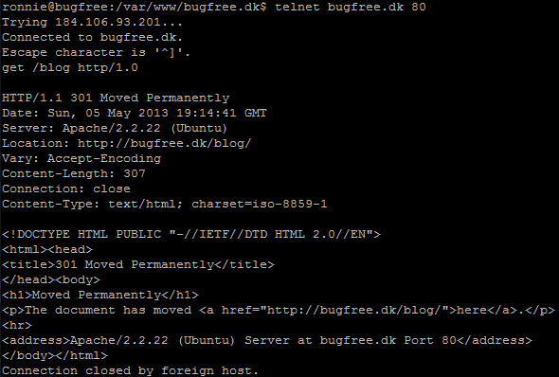
HTTP protocol
HTTP protocol is stateless
telnet bugfree.dk 80 get /blog HTTP/1.0
Example: Google Developer Toolbar

Slide 5
Server-side event handling
HTTP is stateless
Makes events appear as in Winform or WPF application
ASP.NET web control events result in postback to the server

Slide 6
Web project types
ASP.NET web application
Allows for most control of project output
Useful when you have multiple projects in your solution, one being the web application project
Web page composed of .aspx (markup), .designer.cs (designer-generated code), and primary C# code behind file
ASP.NET web sites
Hides the .designer.cs file/creates it in memory
Can be deployed to production as-is, without compiling the project
Bin folders simplifies referencing additional DLLs
ASP.NET MVC

Slide 7
Demo: hello world ASP.NET
Example of <%=1 + 2%>
Example of setting label’s Text property
Illustrates code behind
UI constructed using various web controls
Example of clicking button
Look at generated HTML
Example with runat=“server” attribute
Example with Response.Write
Illustrate compilation model with ILSpy

Slide 8
Page inheritance chain
Object
Page: Request, Response, Application, Session, IsPostBack
Control: ID, Page, Parent, Controls, Visible
Control
TemplateControl
WebControl
Page
TextBox
Button
Default
About
Contact

Slide 9
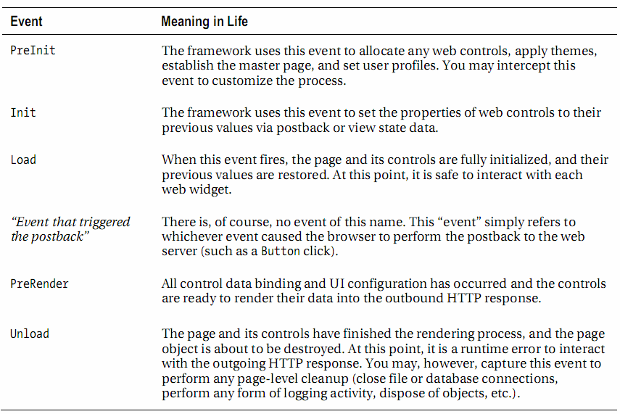
Page life cycle
Most important events (Template pattern)

Slide 10
Web controls
Classes that are the building blocks of ASP.NET pages
Generate HTML by taking browser capabilities into account
Exposes set of events on server side, e.g., button clicked
Web control eventually becomes a member variable of the Page subclass available server-side
<asp:TextBox ID="txtNameTextBox" runat="server" BackColor="#C0FFC0"
BorderStyle="Dotted" BorderWidth="3px">
Enter Your Name
</asp:TextBox>

